Slide 1
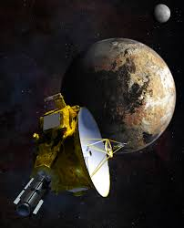
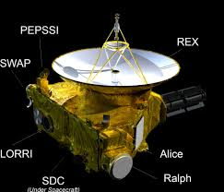
New Horizons Parallax Program
Special Feature
Steve Conard (steve.conard@comcast.net)
Applied Physics Lab – Lead Engineer LORRI Instrument on New Horizons

Slide 2
BLUF and Relevant Links
On 23 April, New Horizons LORRI will image Wolf 359 twice
  04:00 UT (best opportunity for eastern US observers)
  10:00 UT
Amateurs will have the opportunity to collect images at the same time from earth
  With New Horizons 47 AU from earth (4.4 billion miles) and Wolf 359 “only” 7.9 LY away, there is an opportunity to see parallax between the New Horizons images and those amateurs collect
  Expected difference is about 20 arcseconds in position vs. background stars
http://pluto.jhuapl.edu/News-Center/News-Article.php?page=20200129
http://pluto.jhuapl.edu/Learn/Get-Involved.php#Parallax-Program

Slide 3
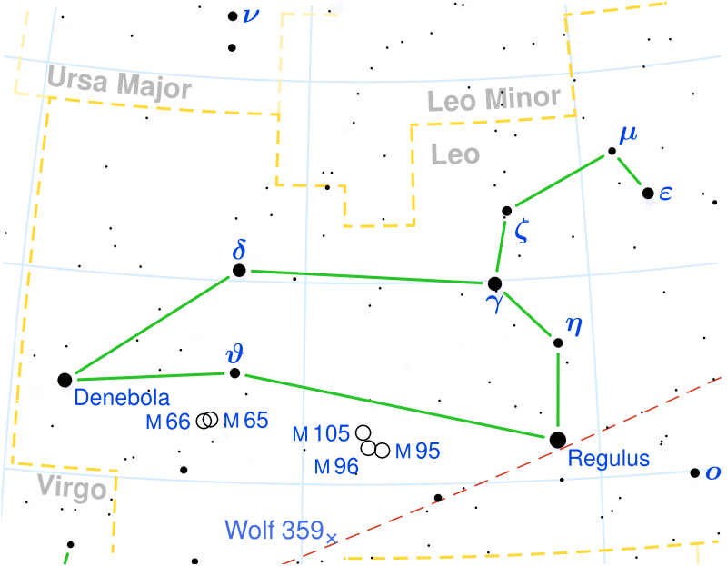
Wolf 359
RA: 10^{h} 56^{m} 28.99^{s}
Dec: +07° 00′ 52.0″
Vmag: 13.54
  But it is pretty red, so it will seem brighter in most modern cameras
Distance 7.9 LY
By Leo_constellation_map.png: Torsten Bronger.derivative work: Kxx (talk) - Leo_constellation_map.png, CC BY-SA 3.0, https://commons.wikimedia.org/w/index.php?curid=10840142

Slide 4
Parallax Angle
New Horizons at 47 AU from sun or 0.00074 LY
  Sanity check 0.00074 LY x 365 D/Y = 0.27 Day or ~6.5 hours – which is approximate the one way light time
Parallax Angle = atan (0.00074 / 7.9) = atan (0.000094) = 0.0054⁰
= 19 arcseconds
New Horizons LORRI 4 x 4 IFOV = 4 arcseconds
  Parallax angle is about 5 LORRI binned pixels

Slide 5
Wolf Star Catalog
Catalog of high proper motion stars
Assembled by Maximilian Franz Joseph Cornelius Wolf (21 June 1863 – 3 October 1932)
  German astronomer and pioneer in astrophotography

Slide 6
Wolf 359 Sci-Fi Fun Facts
Name 3 Mass Media Sci-Fi references to Wolf 359
  Battle of Wolf 359 was referenced in Star Trek: The Next Generation episode, “The Best of Both Worlds”, Part II (1990), and was later seen during the first episode of Star Trek: Deep Space Nine
  “Wolf 359” from The Outer Limits season 2, episode 8 (1964)
  “Wolf 359” podcast, a radio drama about a dysfunctional crew on an aging spacecraft orbiting Wolf 359

Slide 7
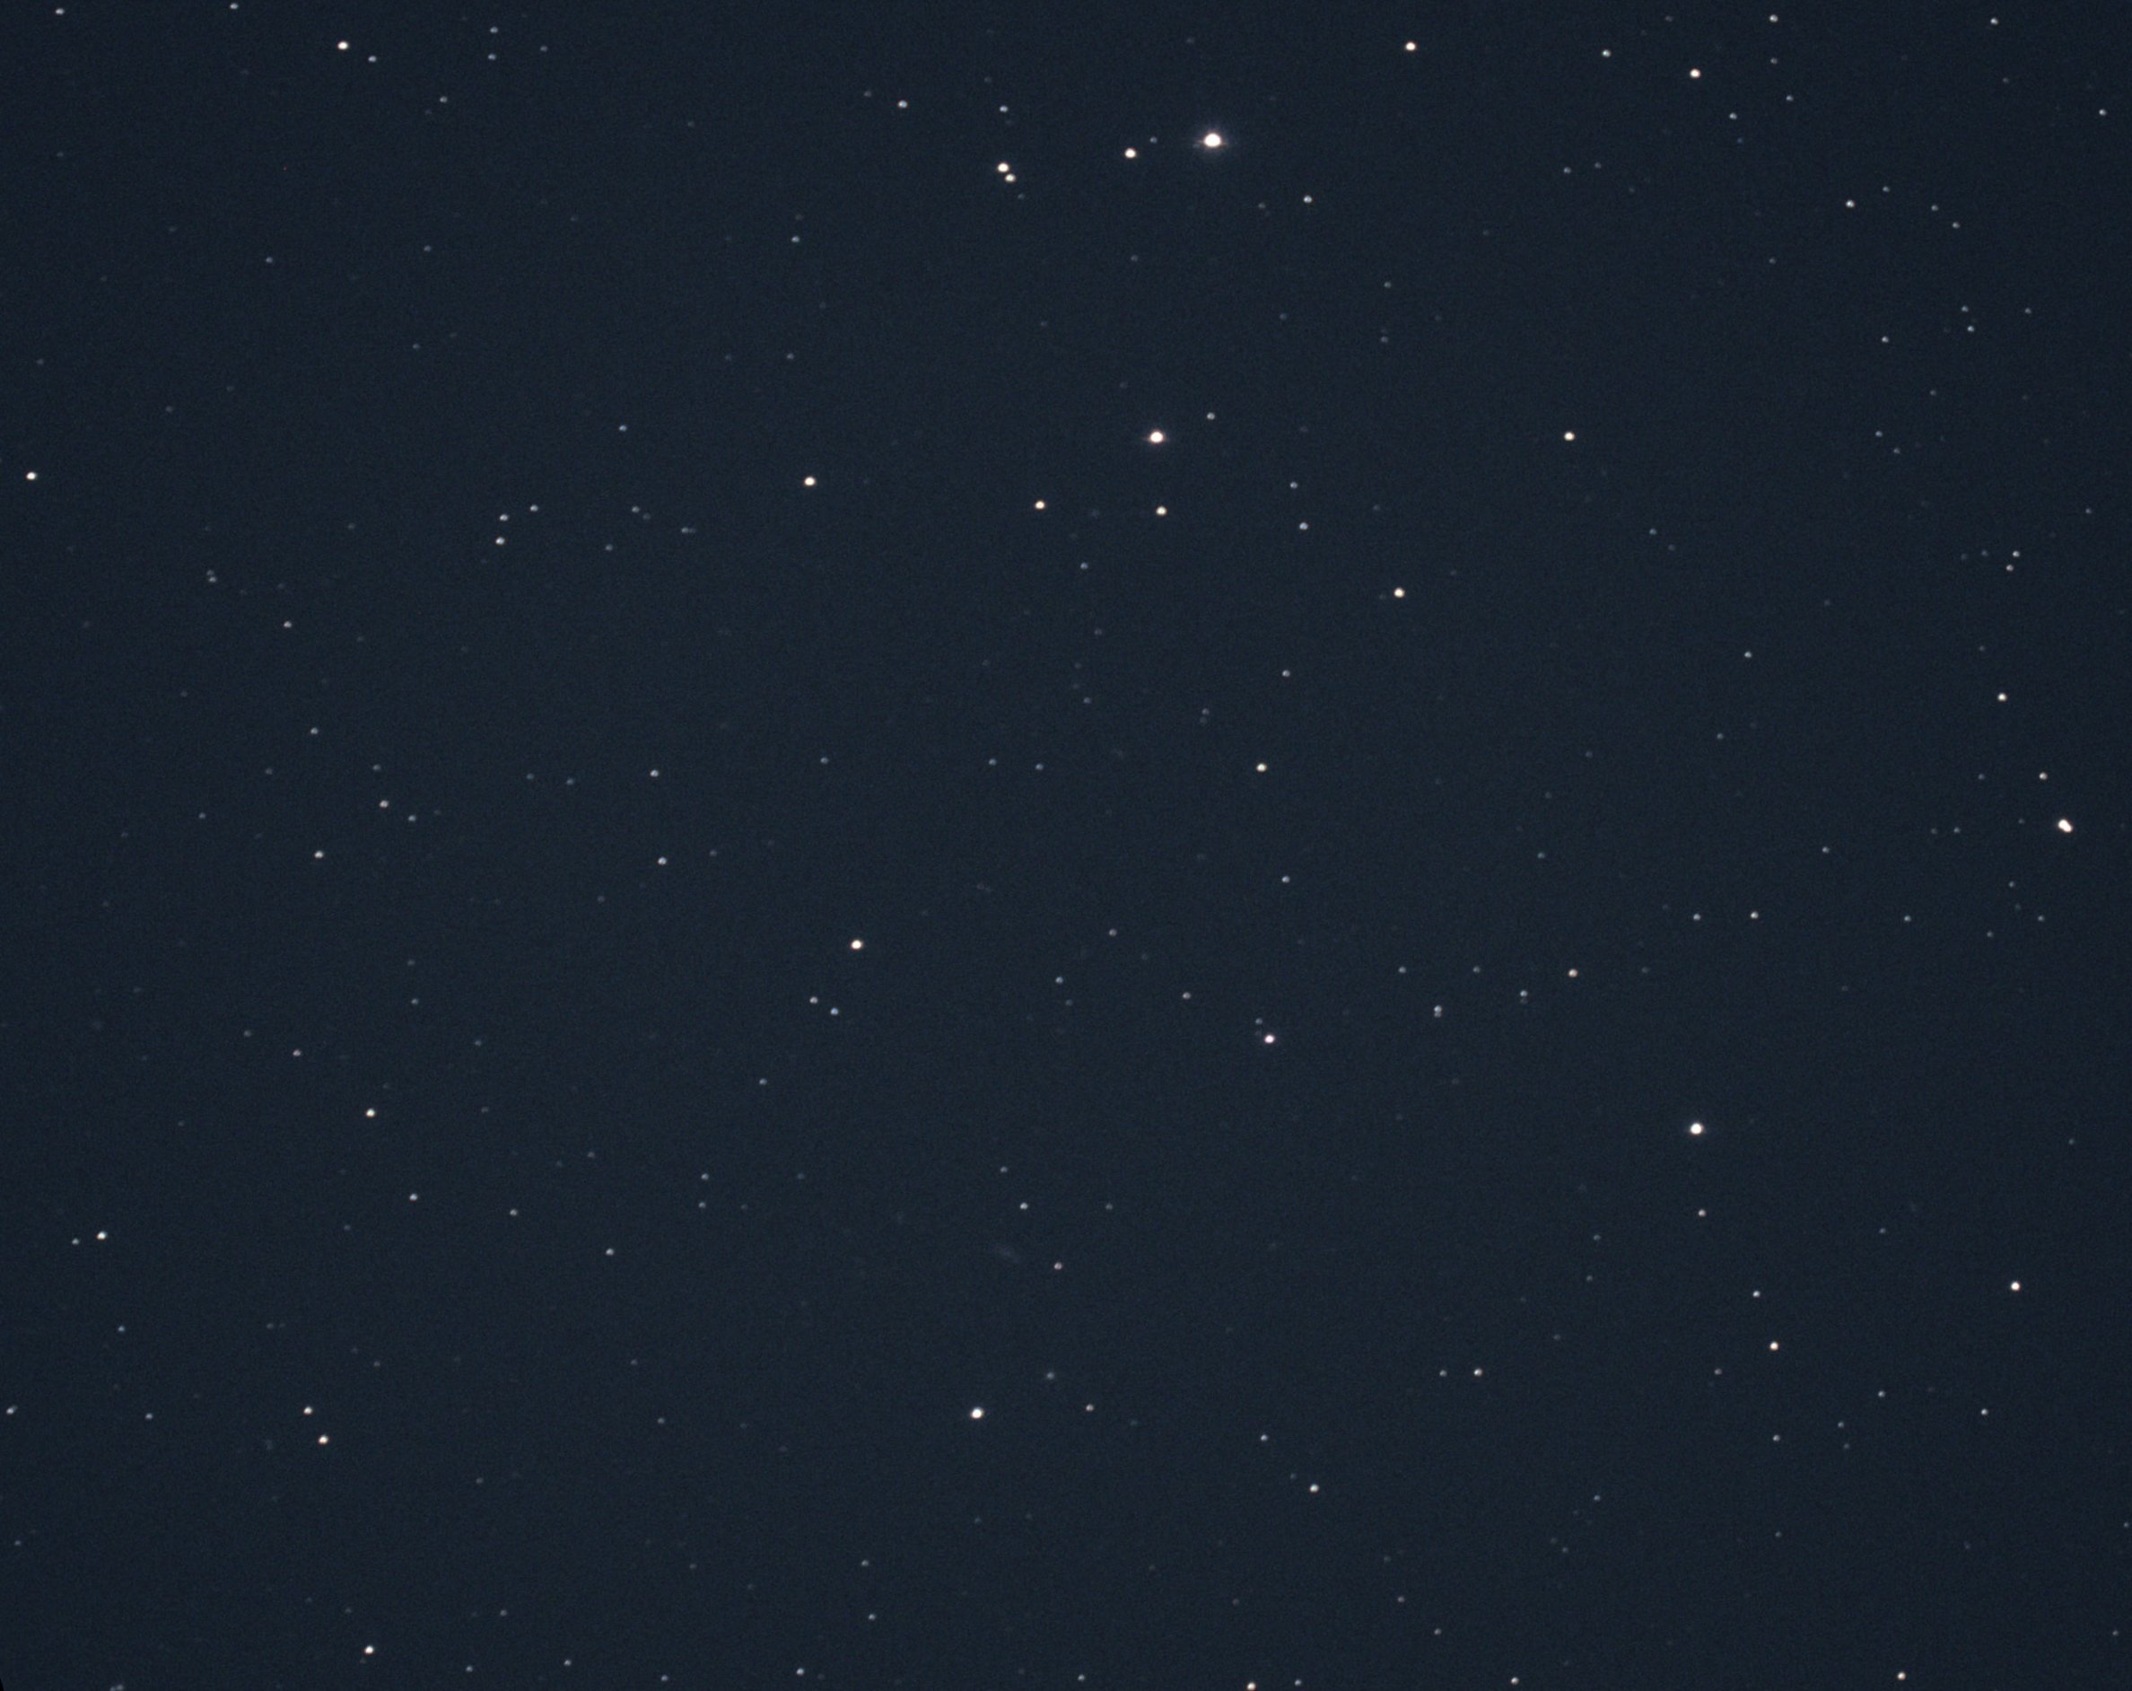
Jackie Donaldson and Steve Conard’s Practice Image
Taken in late February at Willow Oak Observatory (Gamber, MD)
14” SCT with Hyperstar, running at f/1.9
Jackie’s camera—ZWO ASI294MCPro
  Exposure 6 seconds
Rotated (north up), flipped, and cropped to 55 x 44 arcminutes

Slide 8
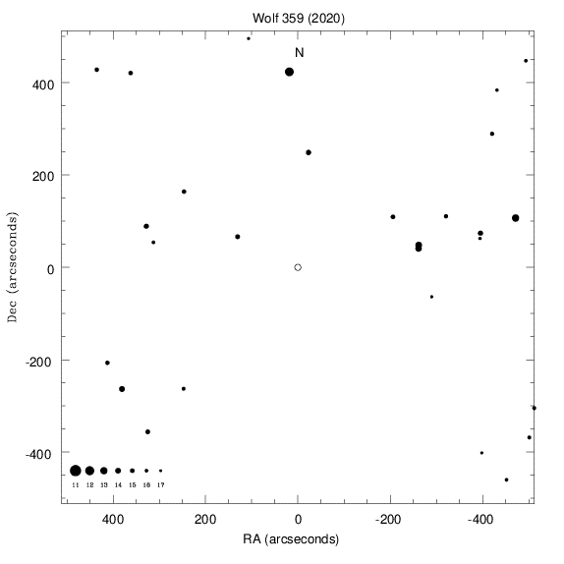
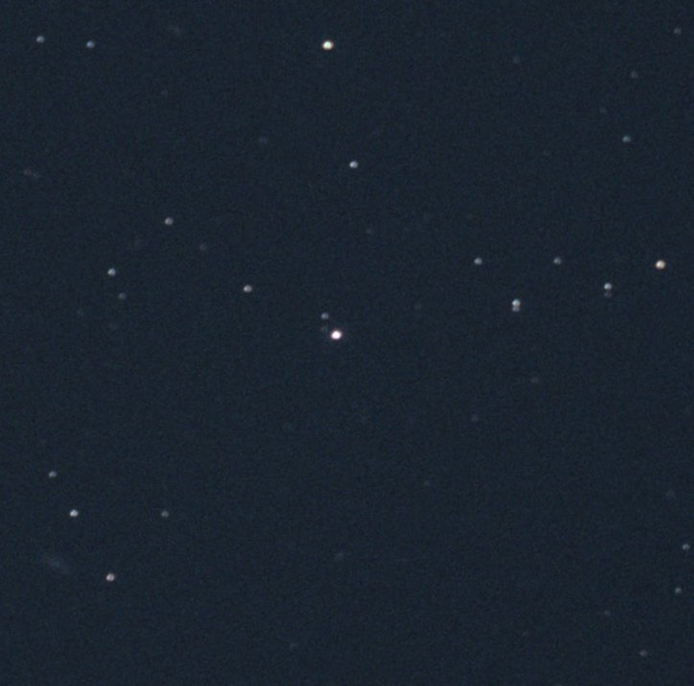
New Horizons Finder Chart vs. Our Photo
Cropped to ~15 x ~15 arcminutes

